Slide 1
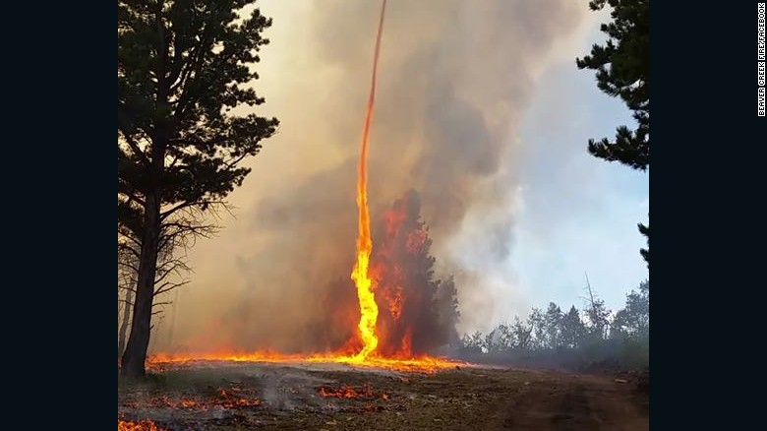
Project Wyldfyrez
Michael, Cristina, Erin, & Drew

Slide 2
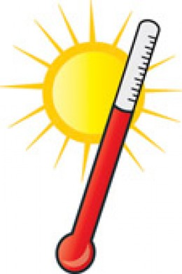
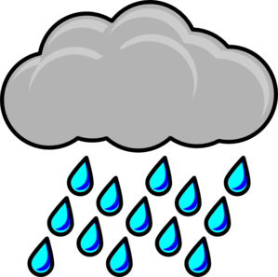
Original Motivation and Questions
How does temperature impact the number of wildfires by state?
How does precipitation impact the number of wildfires by state?
Hypotheses: Higher temperatures lead to more wildfires in a state. Higher precipitation leads to fewer wildfires in a state.

Slide 3

Data Sources
U.S. Forest Service - Geospatial Data: Fire Program Analysis Fire Occurrence Database
Size of each state by acreage
Amount of wilderness by state in acreage
Weather Data - National Centers for Environmental Information
Drought monitor for 2002, 2005, and 2011

Slide 4
The Data We Ended Up With
Fire Data:
A list of each wildfire recorded by the US Forest Service
1992 - 2015
Discovery and containment dates
Fire causes
State
Weather Data:
Average temperature by state
Average maximum temperature by state
Drought conditions

Slide 5

Data Cleanup and Exploration
Cleanup Steps we took:
Remove rows (i.e. fire records) that were missing any data
This removed essentially all data from 1992 through 2004
Check for duplicate records based on the Fire ID (there were none)
Renamed column headers
Check and change data types as necessary (string values to floats)
Stripped out the timestamp from the date values
Created a “Duration” column
Duration = date contained - date discovered
Wrote out a csv based on the cleaned dataframe

Slide 6
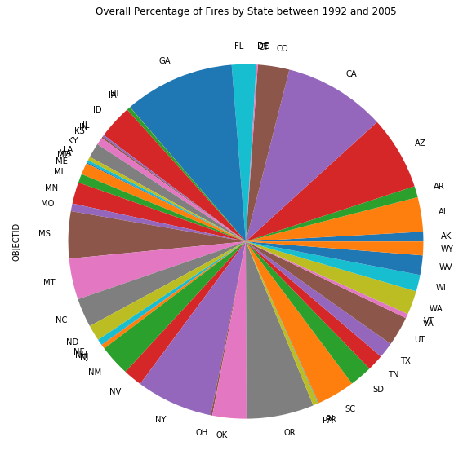
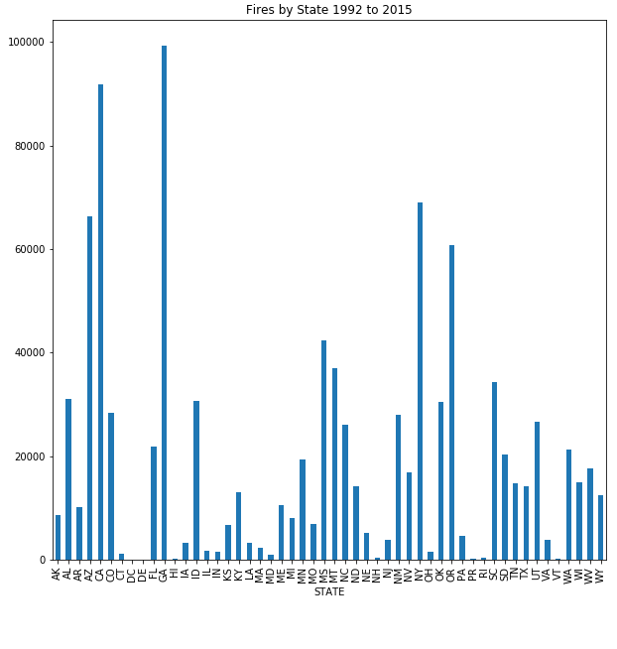
Fires by State

Slide 7
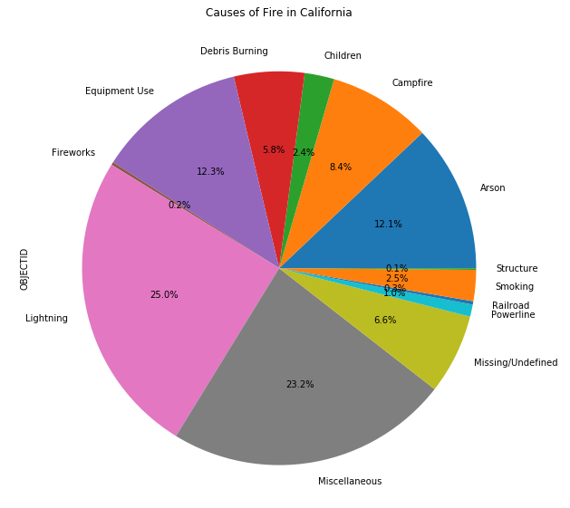
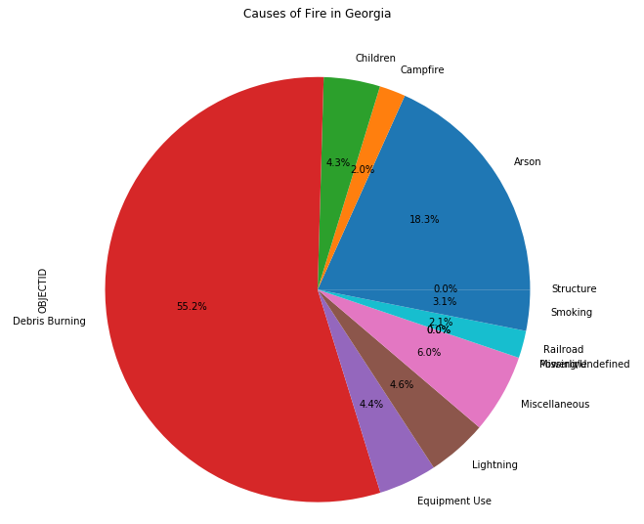
Causes in California vs. Georgia

Slide 8
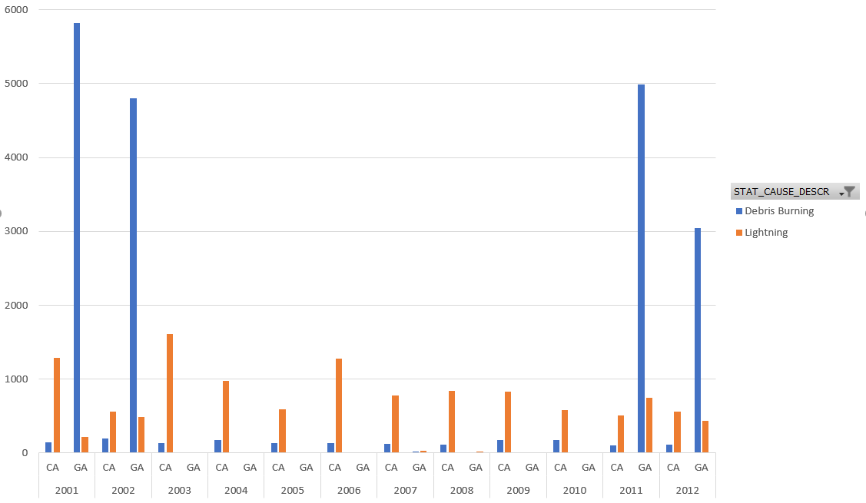
What is That Dip About?
We noticed a significant dip in the number of debris burning-related fires in 2003, with a new spike in 2011. So the question is, what happened in 2002/3 to cause the drop? In 2011 to cause the spike?

Slide 9
Final Data Analysis
After doing some research, we ran into roadblocks with getting the relevant weather data to compare to fire sources and occurrences. There were limits on API calls that we were unable to resolve. In the end, we focused on Georgia’s data because they have had the most wildfires in the last 15 years, and on California’s because we assumed they would have had the most fires in that timeframe, but were incorrect.
So why are there so many debris burning-related fires in Georgia?
What are the differences in California and Georgia’s debris-burning policies?
Georgia now has debris-burning policies in place that require a permit application.
However, California requires a permit for the same kind of burning, which is then further narrowed to only be allowed on certain prescribed days.

Slide 10
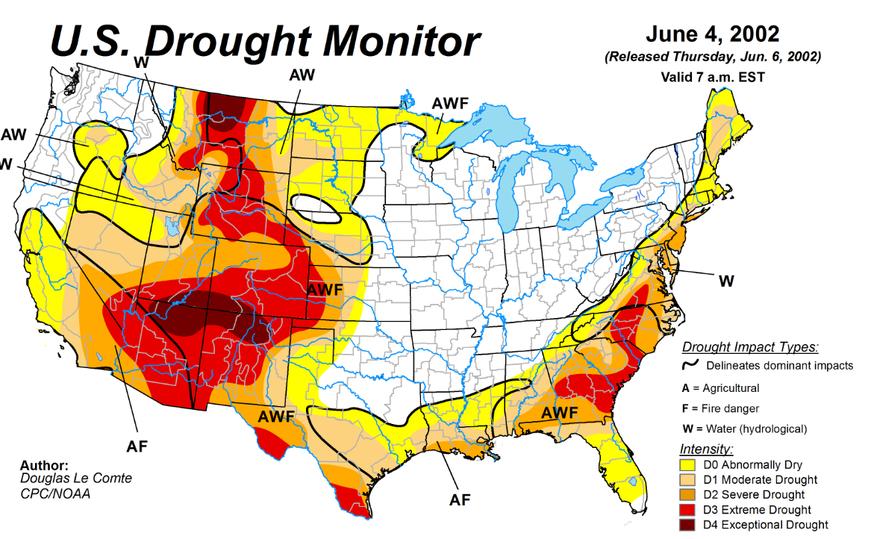
2002 Drought Map
Does drought + debris burning = more wildfires?

Slide 11
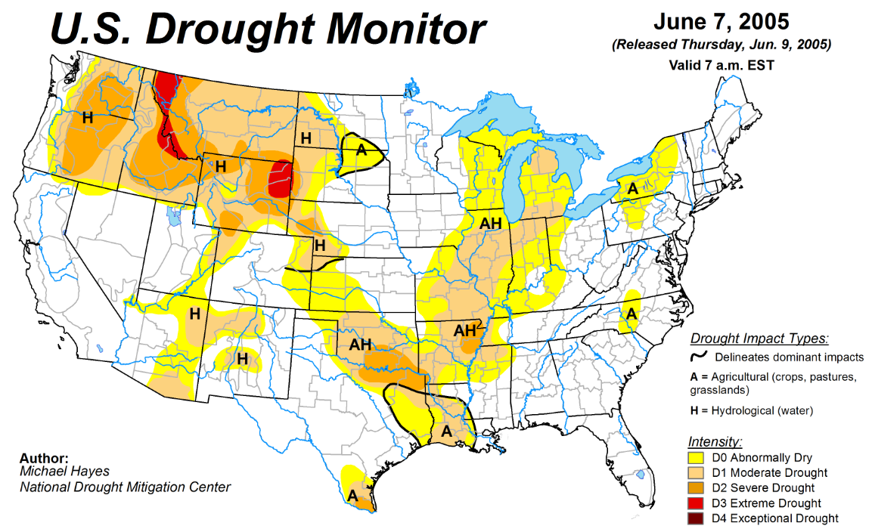
2005 Drought Map
Does NO DROUGHT + debris burning = a steep drop in wildfires?

Slide 12
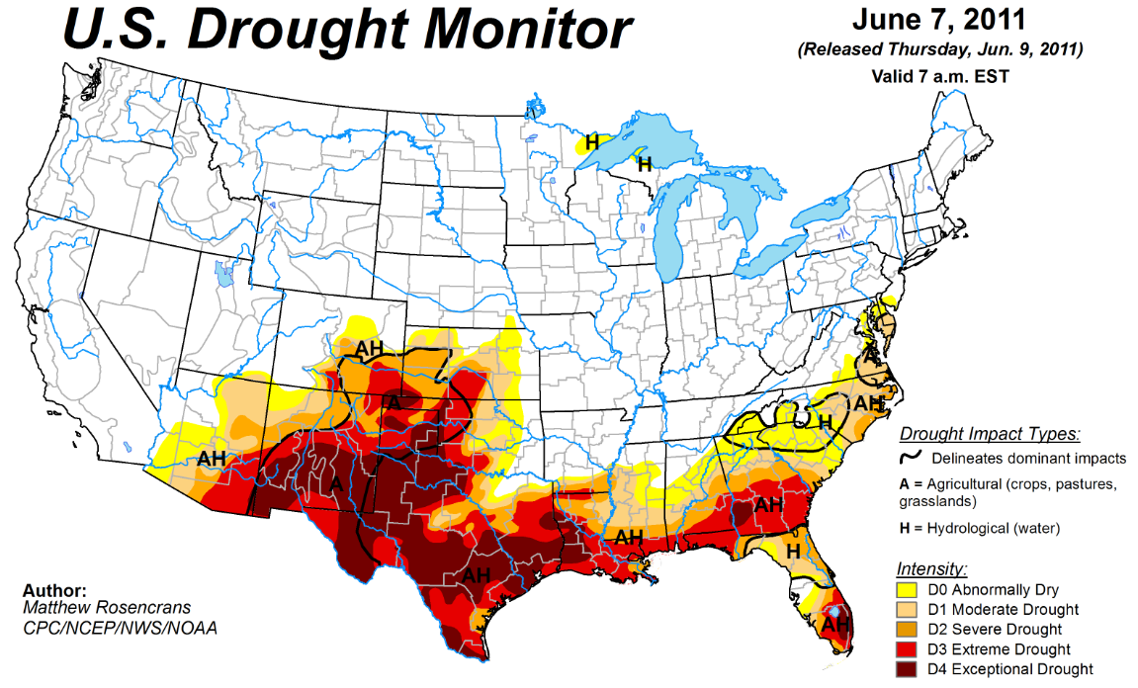
2011 Drought Map
Does small but severe areas of drought + debris burning = a steep, sudden spike in wildfires?

Slide 13
Correlation Between Drought and Wildfires?
Did drought conditions in Georgia have an impact on the number of wildfires in the state?

Slide 14
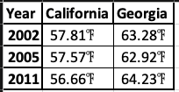
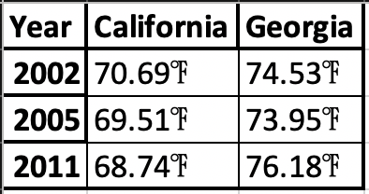
Or Perhaps a Correlation With Temperature?
For example, the rising average yearly temperature in Georgia?
Or the rising average MAXIMUM yearly temperature in Georgia?
https://www.ncdc.noaa.gov/cdo-web/search

Slide 15
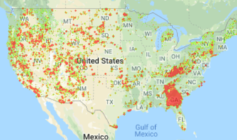
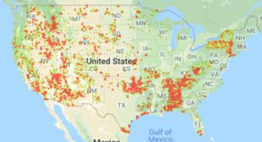
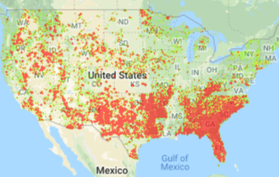
Correlation Between Fire Size and Fires per Year?
2002
2005
2011

Slide 16
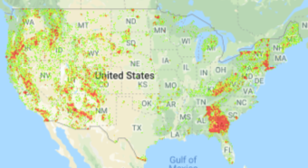
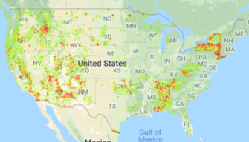
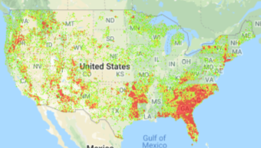
Correlation Between Fire Duration & Fires per Year?
https://gph.is/2RJU2m5
2002
2005
2011

Slide 17
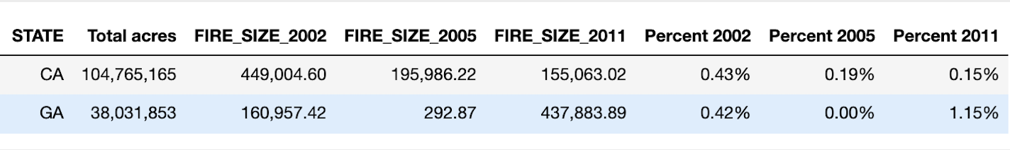
Fire Size Data

Slide 18
Post-Mortem
What we still want to ask/do:
We wish we had found Fire Poker v 2.0 data from weather.gov which specifically gets at fire and weather data.
We would have liked to use the Drought Monitor data to further look into the impact of droughts on incidences of wildfires.
We would have liked to do an analysis for each state and each year in the dataset (that would be 780 analyses!).
We would have liked to compare number of fires to area burned and analyze accordingly.
See if there was a mitigating response by ecosystems to stem fatally cataclysmic fires with ecosystem data on.

Slide 19
Post-Mortem part 2
What was challenging:
Our dataset for the wildfires was pretty large to start with, and so we ran into some memory issues as well as trouble uploading the data into GitHub.
We had difficulty confidently defining “wildland” and “wildfire”.
API call limits for weather data
Limits on how far back in the weather data we could go.

Slide 20
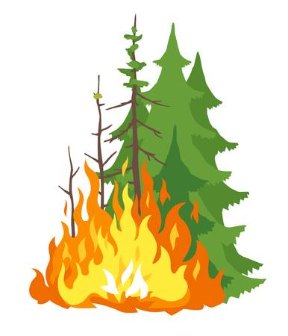
Questions?

